Slide 1

Insight Presentation on (Lost Mileage, Absence and Punctuality)
Presented by Aduragbemi (Michael) Ayeni on 5th of August 2024

Slide 2

Introduction
First Bus is a Ground Passenger Transportation Organisation.
Head Quarter in Aberdeen, Scotland
First Bus is a division of First Group
What we stand for

Slide 3


Business Intelligence(BI) tools used
- Power BI - Advanced EXCEL
Steps Taken
- Data Cleaning and Preparation - ETL process(Extract, Transform and Load - Performed Power query operations - Wrote DAX to ascertain specific measures -Performed data accuracy check - Data Visualization - Report Presentation.

Slide 4
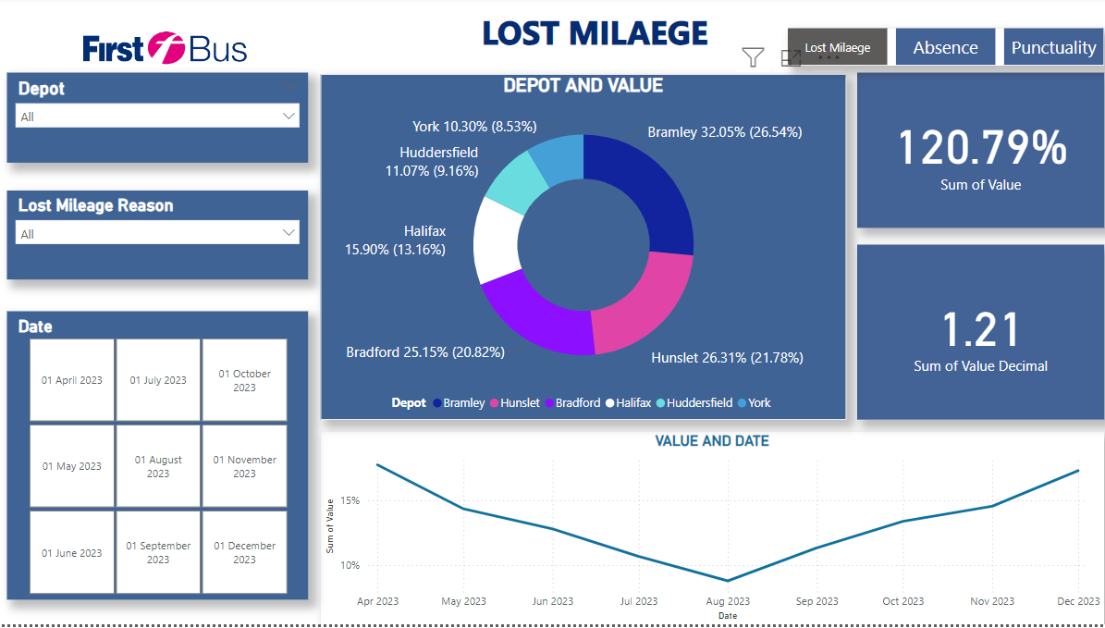
Lost Mileage - Overview
Lost mileage is a term that we use in the bus industry to explain where we haven't run routes, or part of routes that were planned.
Insight - The total lost mileage shows an increasing trend towards the end of the year, peaking in November and December.
- A steady increase is noticeable from September onwards.

Slide 5
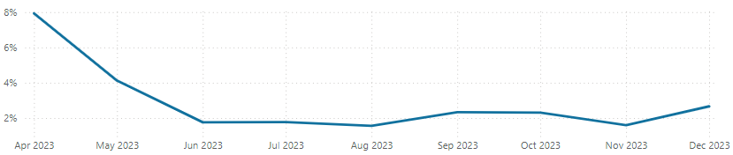
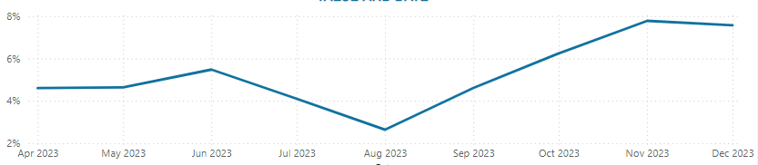
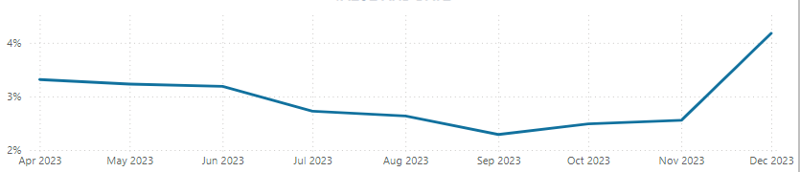
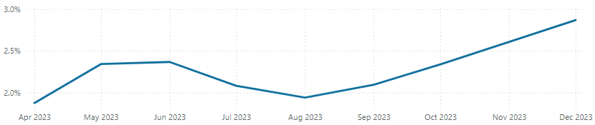
Lost Mileage – Contd.
Driver
Traffic
Insight Remains relatively stable with minor fluctuations.
A noticeable peak in December indicates potential seasonal impacts or specific events affecting driver performance.
Insight Shows a clear upward trend, especially in the last quarter.
The significant rise in November and December highlights worsening traffic conditions or increased congestion during these months.
Vehicle
Other
Insight :Generally stable throughout the year but with a noticeable increase in December.
Indicates potential maintenance or operational issues surfacing towards the year's end
Insight: Gradual increase over the months with significant peaks in November and December.
This suggests accumulating minor issues or new emerging factors that need addressing

Slide 6
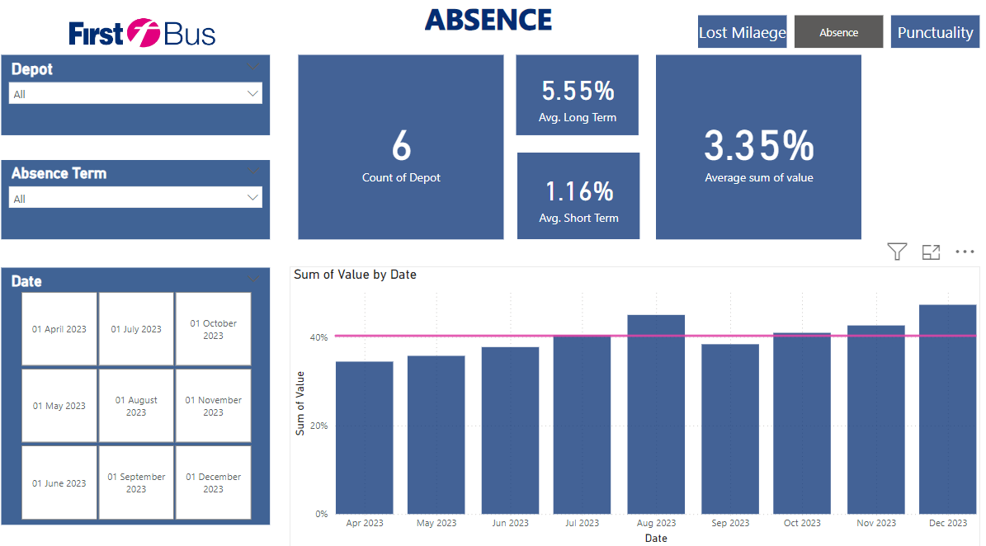
Absence - Overview
Insight: Long Term absences are consistently higher than Short Term absences across all depots. Bramley: Should investigate and address the reasons behind high Long-Term absences. Huddersfield: Both Short Term and Long-Term absences increase towards the year-end, needing proactive measures.
Hunslet: Faces high Long-Term absences throughout the year, requiring immediate attention. Halifax: Shows a balanced pattern but with notable Long-Term absences that peak in mid-year.
Bradford: Needs to address both Short Term and Long-Term absences, particularly focusing on Long Term issues which are significantly high. York: Has relatively lower averages but still needs to manage Long Term absences efficiently.

Slide 7
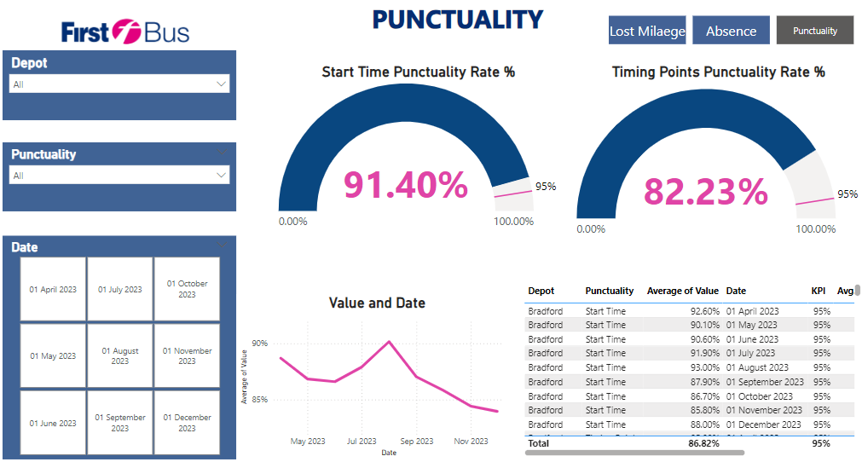
Punctuality - Overview
Start time punctuality refers to a bus starting its route at the place of origin on time. Timing point punctuality looks at bus on time performance at specific points on a route according to the plan. August 2023 appears to be a peak month for punctuality across most depots.
York consistently shows the highest punctuality rates for both start times and timing points.
Bradford and Halifax show a noticeable decline in punctuality towards the end of the year, especially in timing points.
KPI Measure added as a benchmark to determine Clear satisfaction with start point timing point punctuality

Slide 8
Further Insight Recommendation
I recommend we dive into other ground passenger transport company comparing our current position with others to see how we stand within the bus industry. Open-source data are available on Statistics at DfT and Office for National Statistics (ONS) Geoportal.
Further analysis needs to be carried out on ‘Other’ reason adding to the lost milage factor.
Separate data pipeline needs to be developed to fully understand activities toward the end of the year.
Predictive analysis is recommended once stakeholder set KPI and benchmarks, especially in Punctuality.

Slide 9
Thank you

